Slide 1

ITIL® 4 Foundation Certification Course
Lesson 6: ITIL 4 Foundation Examination Format
Based on AXELOS ITIL® material.
ITIL® is a [registered] trade mark of AXELOS Limited.

Slide 2


Learning Objectives
By the end of this lesson, you will be able to:
Outline the purpose of ITIL 4 Foundation examination
Discover the ITIL 4 Foundation examination design
Interpret the ITIL 4 Foundation question types and examples
Evaluate the scoring methods of ITIL 4 Foundation
Discuss the weightings by Bloom’s level and learning outcomes

Slide 3

Purpose of ITIL 4 Foundation Examination
Assess whether the candidate can demonstrate sufficient recall and understanding of the ITIL 4 service management framework, as described in the syllabus, to be awarded the ITIL 4 Foundation qualification
Make the learners of ITIL 4 Foundation qualification eligible for the higher level qualifications of ITIL 4
4

Slide 4

ITIL 4 Foundation Examination Design
ITIL 4 Foundation is a “closed book” examination. No materials other than the examination materials are permitted
The duration is 60 minutes
The candidates taking the exam in a language that is not their native or working language may be awarded 25% extra time, that is 75 minutes in total.

Slide 5
ITIL 4 Foundation Question Types
All forty questions are Objective Test Questions (OTQs), with four options from which one option is selected.
Distractors or wrong answers are the options that candidates with incomplete knowledge or skill would be likely to choose. These are generally plausible responses relating to the syllabus area being examined.
Question styles used within this type are:
Standard
Missing word
List two correct items
Negative standard OTQ

Slide 6
Examples: Question Types
STANDARD
What is the best practice for Service Value Chain?
Q
P
R
S

Slide 7
Examples: Question Types
MISSING WORD
Identify the missing word(s) in the following sentence.
A [?] defines requirements for services and takes responsibility for outcomes from service consumption.
Role Q
Role P
Role R
Role S

Slide 8
Examples: Question Types
LIST TWO CORRECT ITEMS
Which statement about service asset and configuration management is CORRECT?
It does Q
It does P
It does R
It does S
1 and 2
2 and 3
3 and 4
1 and 4
Note: Two of the list items are correct. List style questions are never negative.

Slide 9
Examples: Question Types
NEGATIVE STANDARD OTQ
Which is NOT a defined area of value?
Q
P
R
S
Note: Negative questions are only used, as an exception, where part of the learning
outcome is to know that something is not done or should not occur.

Slide 10
Scoring
Number of questions: 40
Marks: Each question is worth 1 mark
Total marks: 40 marks
There is no negative marking
Provisional pass marks: 65% or higher, meaning a raw score of 26 marks or above

Slide 11
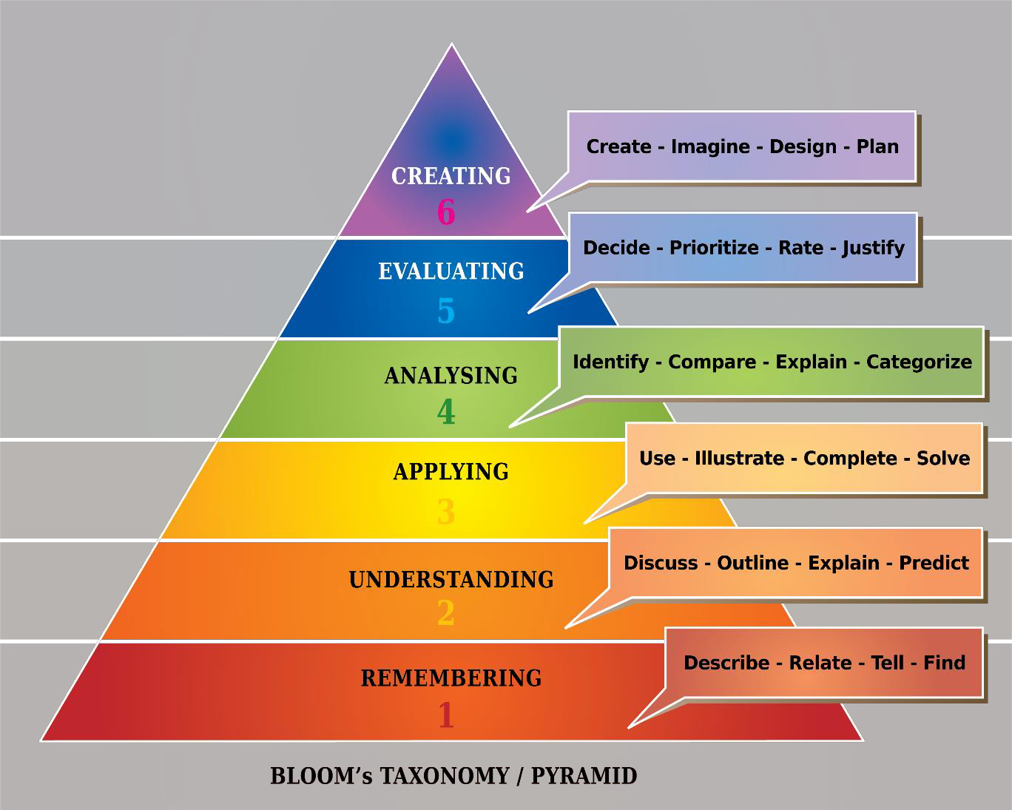
Weightings By Bloom’s Level
ITIL Foundation focuses on first two levels of Bloom’s taxonomy.
Source: Bloom’s Taxonomy

Slide 12
Weightings By Bloom’s Level
There are 9 questions at Bloom’s Level 1 = approximately 22.5%
There are 31 questions at Bloom’s Level 2 = approximately 77.5%

Slide 13
Weightings By Learning Outcome
Learning Outcome | No of Questions | Approximate Weighting
Understand the key service concepts | 5 | 12.5%
Understand how the ITIL guiding principles can help an organization adopt and adapt service management | 6 | 15%
Understand the four dimensions | 2 | 5%
Understand the purpose and components of the ITIL service value system | 1 | 2.5%
Understand the activities of the service value chain, and how they interconnect | 2 | 5%
Know the purpose and key terms of 15 ITIL practices | 7 | 17.5%
Understand 7 ITIL practices | 17 | 42.5%
© ITIL 4 Foundation Exam Specification, January 2019, Page 8

Slide 14
Thank You
ITIL® 4 Foundation Certification Course
Based on AXELOS ITIL® material.
ITIL® is a [registered] trade mark of AXELOS Limited.

